Slide 1
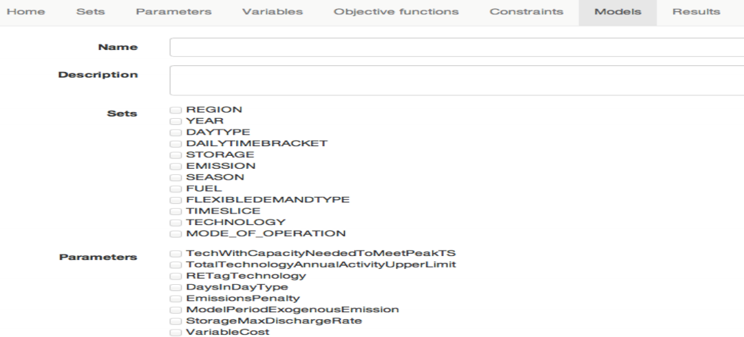
Creating a new model in MoManI
On the (Models) page scroll down and click on (create new model), which will lead you to a new page where you can fill-in the model name (SimpleModel).

Slide 2
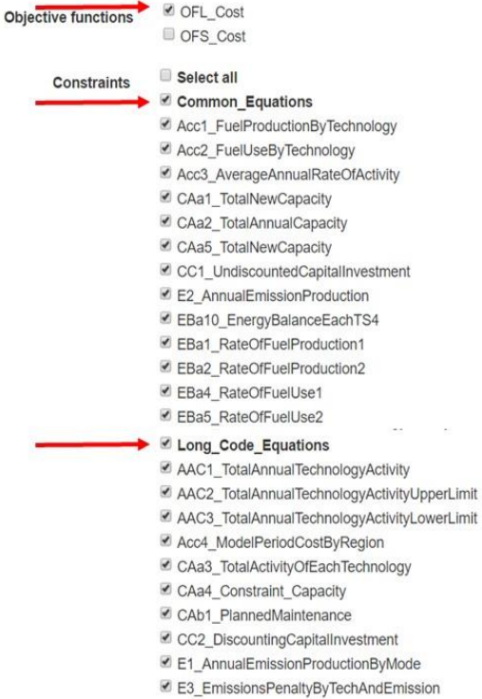
Creating a new model in MoManI
Then select the long code equations of OSeMOSYS, by ticking:
Objective function for the long code (OFL_Code)
Common_Equations
Long_Code_Equations
The required sets, parameters and Variables are then selected automatically.
Remember to click Save at the end of the operation!

Slide 3
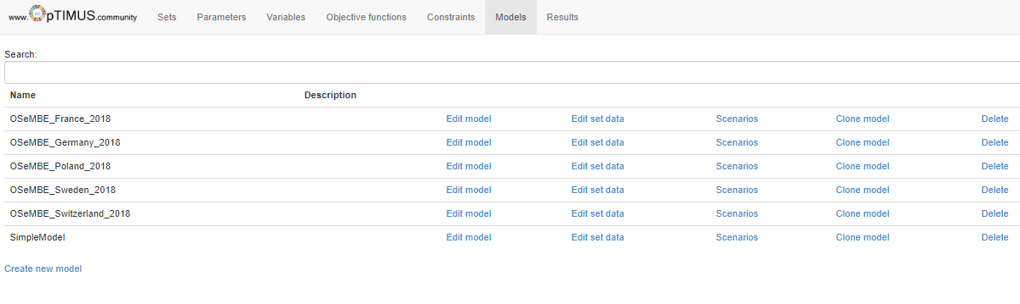
Creating a new model in MoManI
Select

Slide 4
Creating a new model in MoManI
Following, we need to enter in the model the following information for the related sets
*Timeslices: SD (Summer Day), SN (Summer Night), WD (Winter Day), WN (Winter Night), ID (Intermediate Day), IN (Intermediate Night)
Set | Entries
MODE_OF_OPERATION | 1, 2
REGION | SIMPLICITY
TIMESLICE* | SD, SN, WD, WN, ID, IN
YEAR | 2014, 2015, 2016…..2040

Slide 5
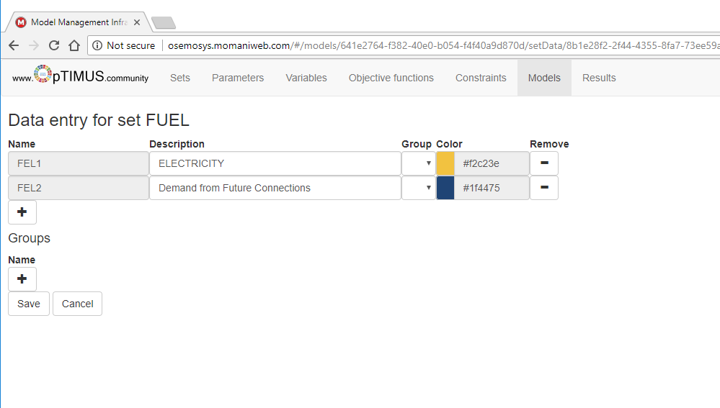
Defining electricity demand in households
Then, we need to create fuels (Set FUEL) to represent final consumption of electricity (let’s call these FEL1 for electricity for already grid connected households and FEL2 for demand from future connections)
Don’t forget to click ’Save’!!

Slide 6
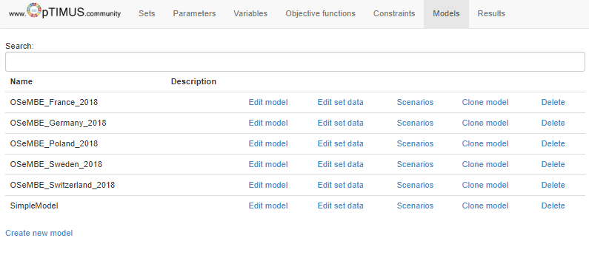
Defining electricity demand in households
Now click ’Back to model list’
In the model list, select ’Scenarios’ of your model
Here click on ’Enter data’

